Slide 1
IOT Based Air Monitoring System
Submitted By,
B. Naveen
20311A04D9

Slide 2

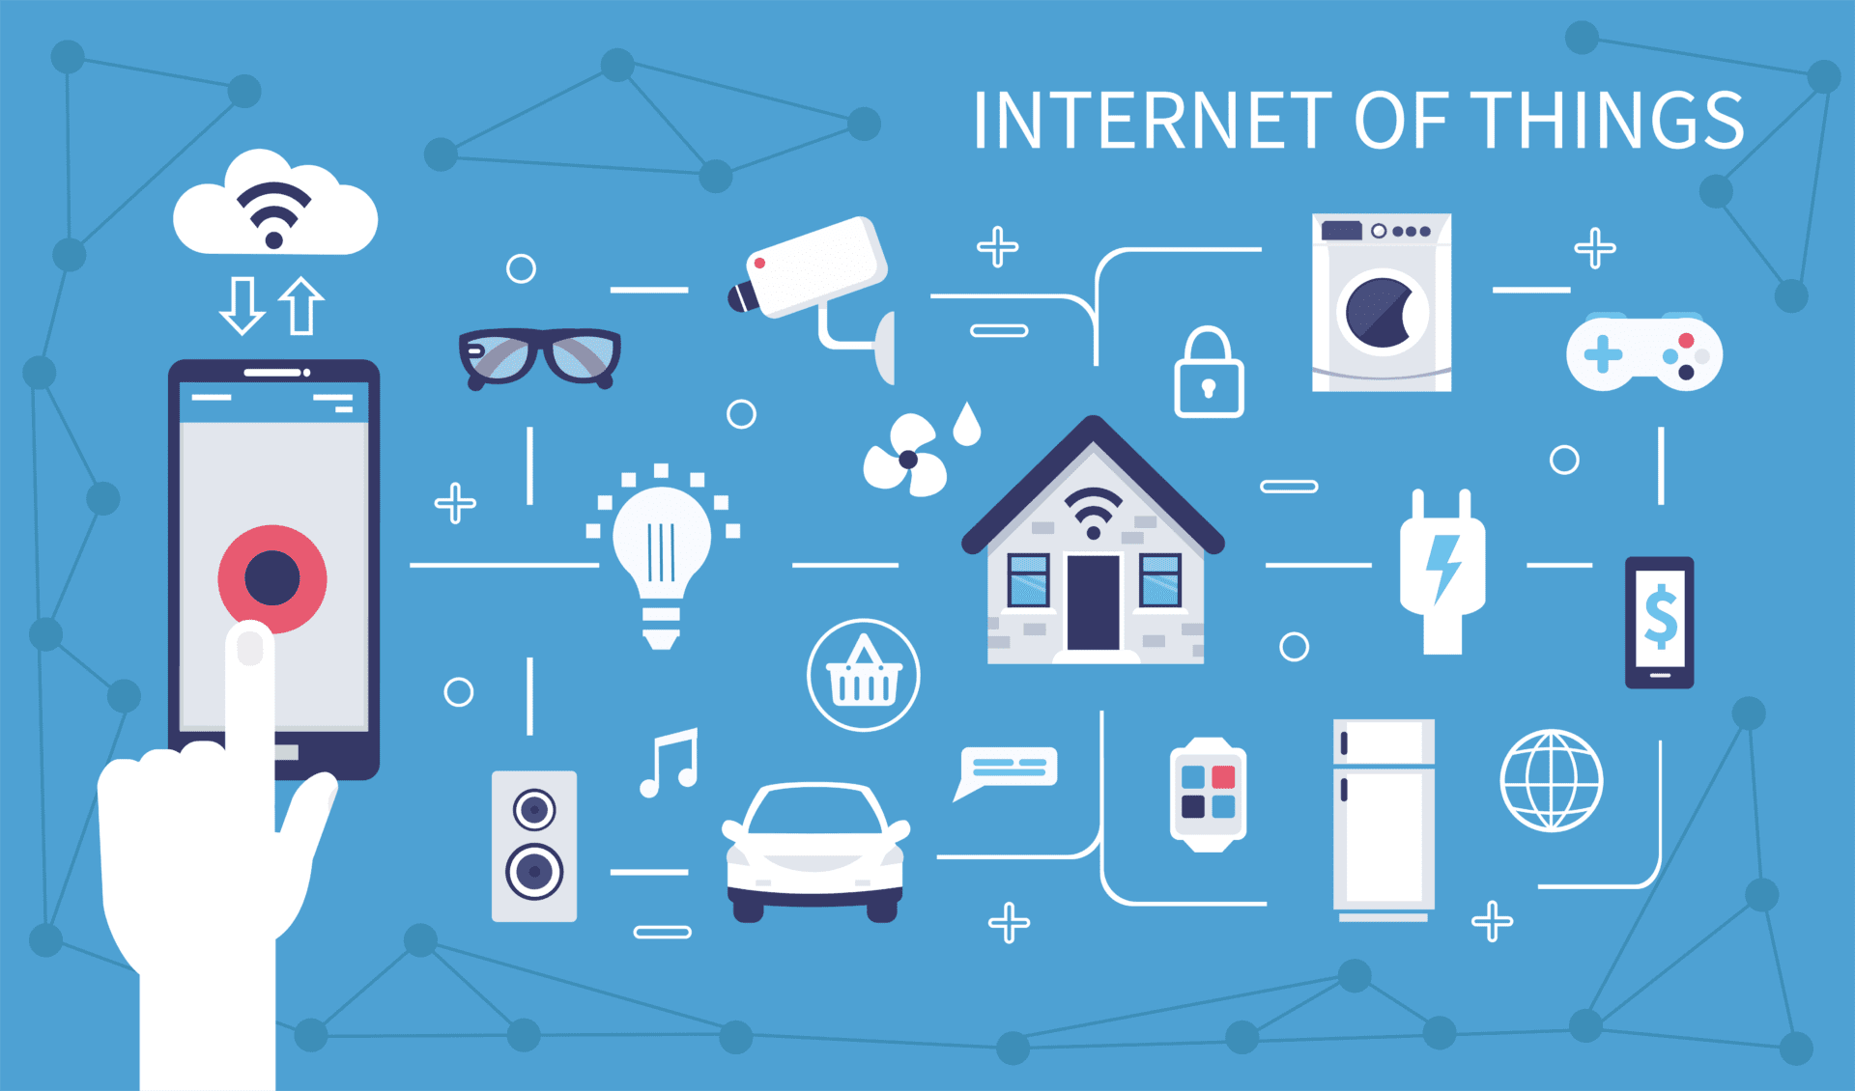
Why IOT ?
The Internet of Things (IoT) describes the network of physical objects—“things”—that are embedded with sensors, software, and other technologies for the purpose of connecting and exchanging data with other devices and systems over the internet. These devices range from ordinary household objects to sophisticated industrial tools. The field has evolved due to the convergence of multiple technologies, including ubiquitous computing, commodity sensors, increasingly powerful embedded systems, and machine learning.

Slide 3
AIM
Air is getting polluted because of the release of toxic gases by industries, vehicle emissions and increased concentration of harmful gases and particulate matter in the atmosphere. The level of pollution is increasing rapidly due to factors like industries, urbanization, increase in population, vehicle use which can affect human health. Particulate matter is one of the most important parameters having a significant contribution to the increase in air pollution. This creates a need for measurement and analysis of real-time air quality monitoring so that appropriate decisions can be taken in a timely period. This paper presents real-time standalone air quality monitoring. Internet of Things (IoT)is nowadays finding profound use in each and every sector, plays a key role in our air quality monitoring system too. The setup will show the air quality in PPM on the webpage so that we can monitor it very easily. In this IoT project, we can monitor the pollution level from anywhere using your computer or mobile.

Slide 4
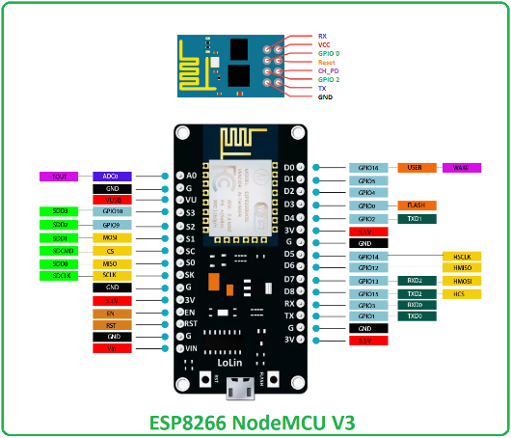
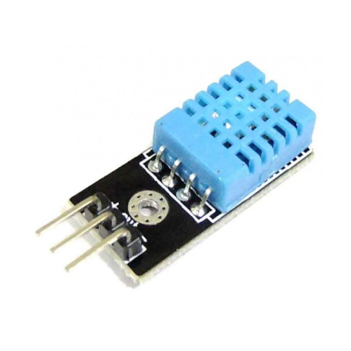
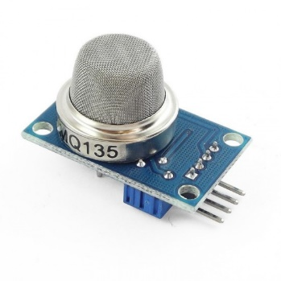
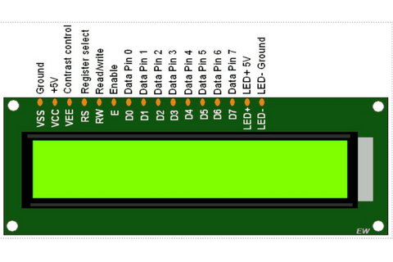
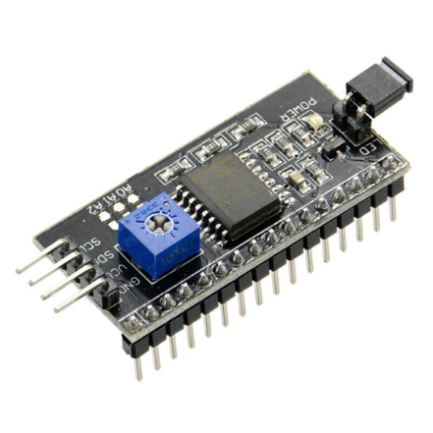
Components

Slide 5
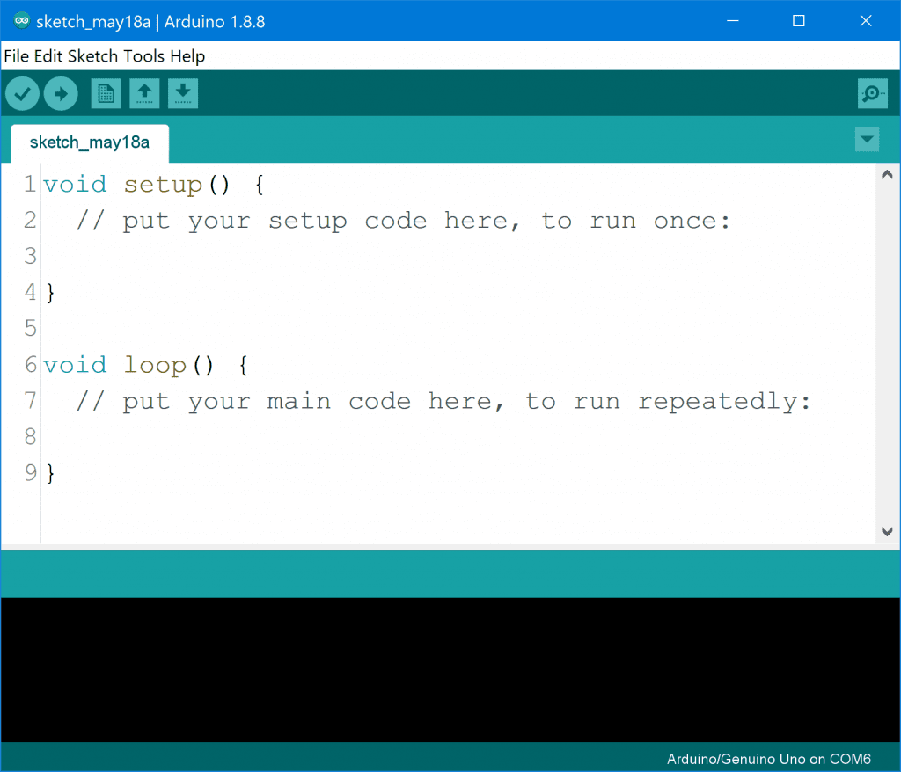
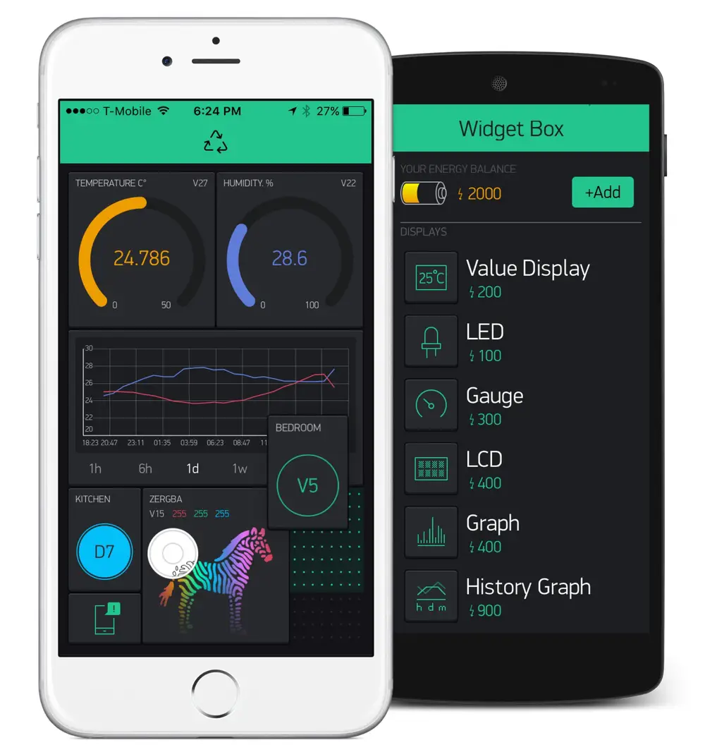
Softwares used

Slide 6
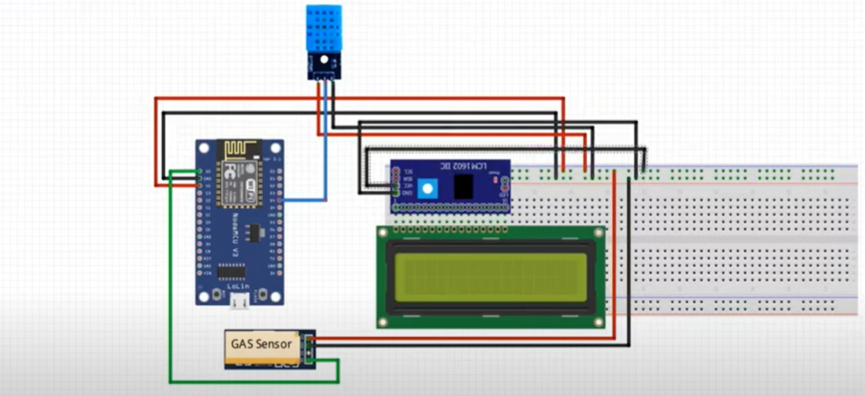
Circuit Diagram

Slide 7
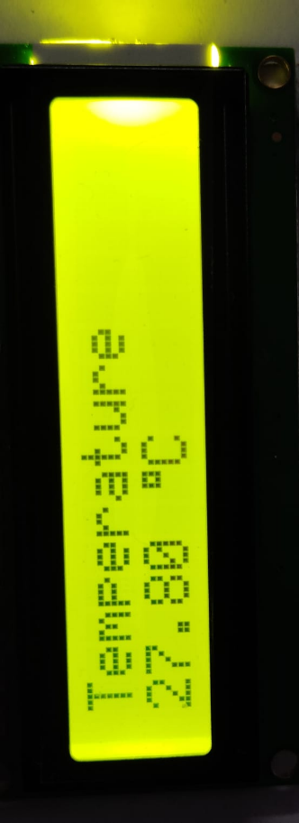
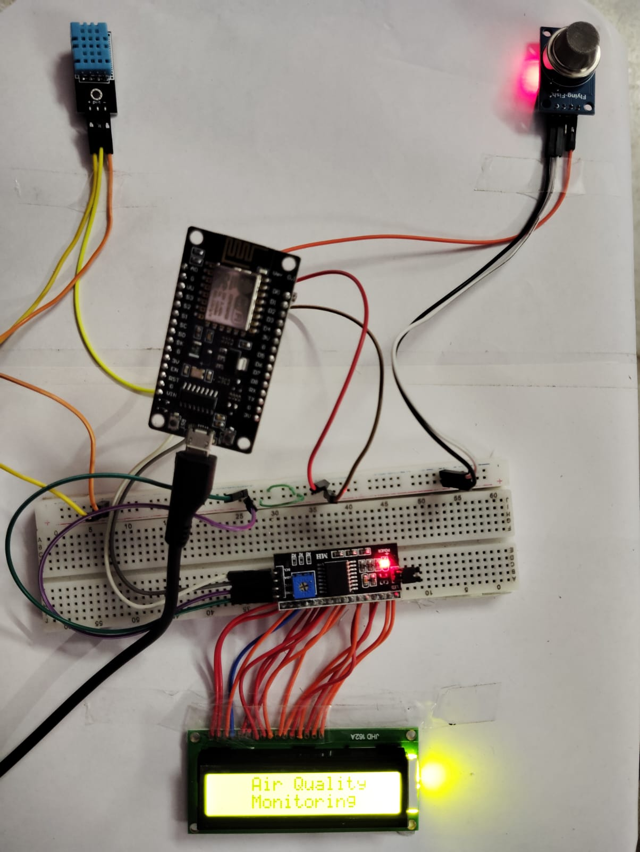
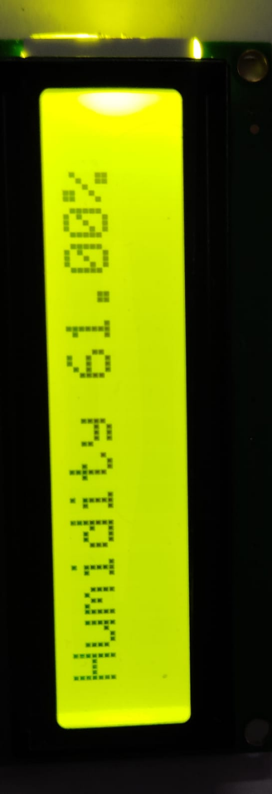
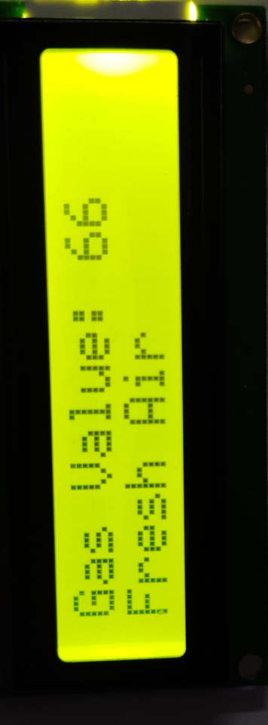
Results

Slide 8
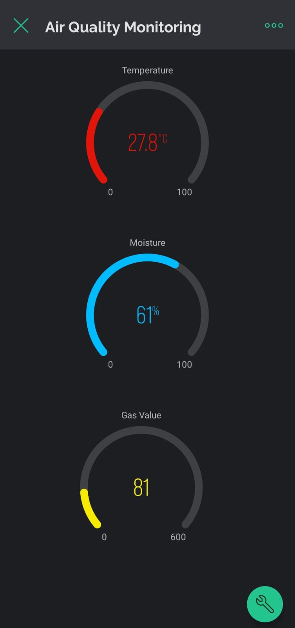
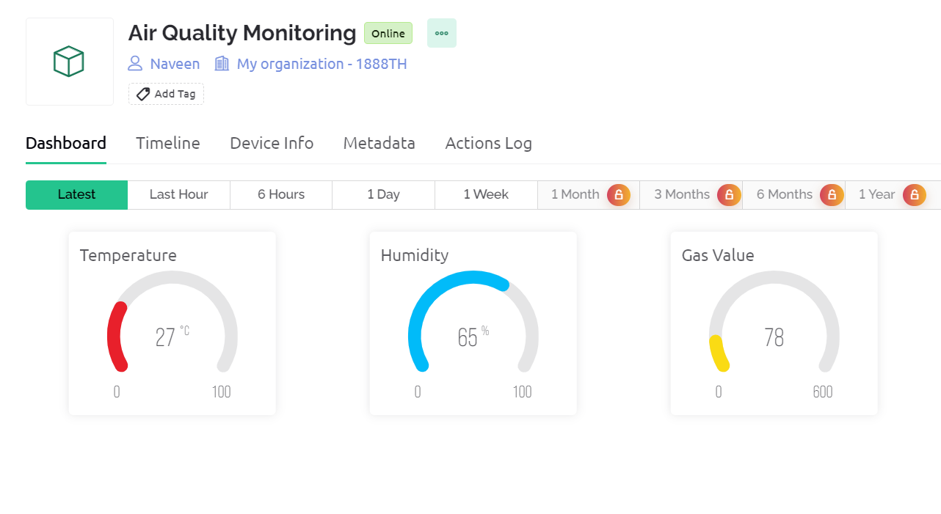
Software (application) Results

Slide 9
Conclusion
The IoT-based Air Quality Monitoring System successfully provides a comprehensive solution for real-time monitoring of crucial environmental parameters. By integrating sensors like the DHT11 for temperature and humidity and the MQ-135 for air quality, coupled with an ESP8266 microcontroller and an I2C LCD display, the system offers both local visualization and remote monitoring capabilities through the Blynk IoT platform.
The project's key features include continuous monitoring of temperature, humidity, and air quality, enabling users to stay informed about their surroundings. The local display on the 16x2 LCD offers immediate feedback, while the Blynk app provides a remote interface for accessing real-time data.

